Slide 1
SNACK CART POINT OF SALES
Purpose: POS system for a snack cart
User: Children with developmental disabilities (limited reading and math skills)
Requirements
BACKEND
Teachers must be able to add items to the cart’s database, select whether they should show in the cart, assign them images, and set their price.
FRONTEND
Students must be able to click (touch) items to add them to the sopping order. Once added a total must be presented. This total then needs a way to aid the students in accepting payment. The system should help students determine if change is needed and how much. There must be a way to reset the register once the transaction is completed.
DESIGN CONSIDERATIONS
The intended use case for this solution is on a tablet or laptop in widescreen layout. Phone is not a consideration due to the amount of information needed to be shown and the intended userbase.

Slide 2
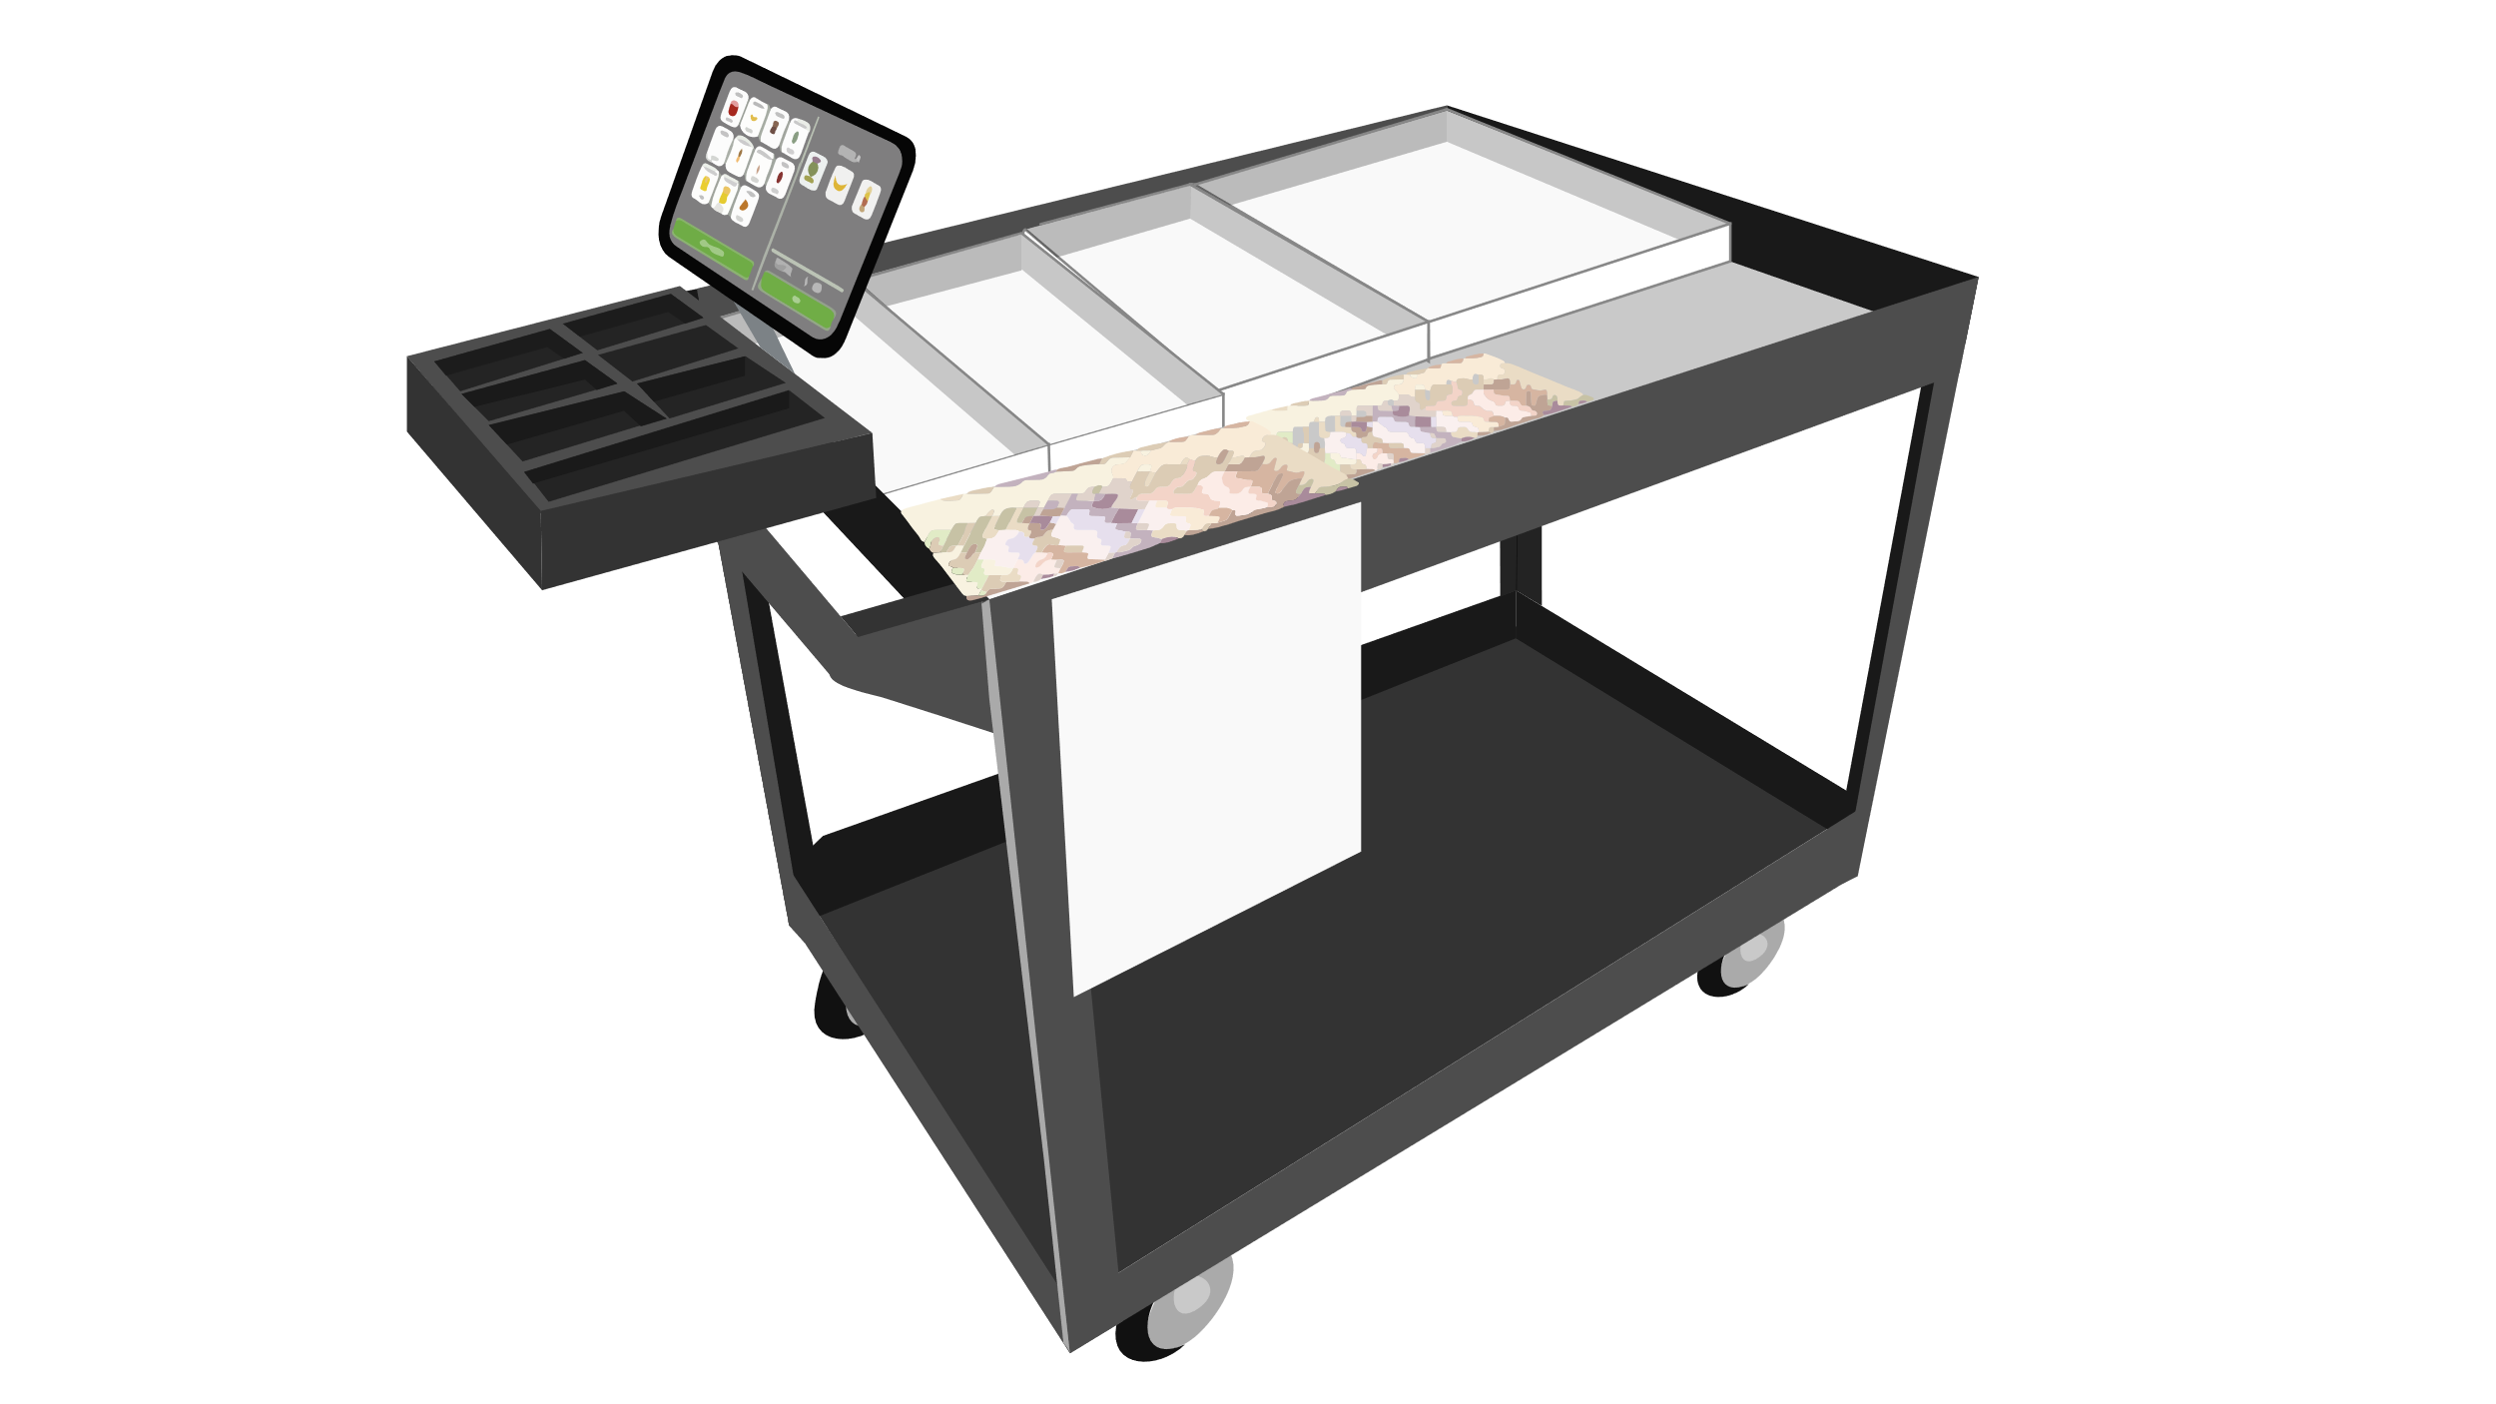
HOME SCREEN
SNACK CART PLUS
CART ADMINISTRATION
Log in to add additional items, change prices and manage your inventory.
Username
Password
Forgot Password?
Log In
CART CODE
ACCESS STUDENT SIDE

Slide 3










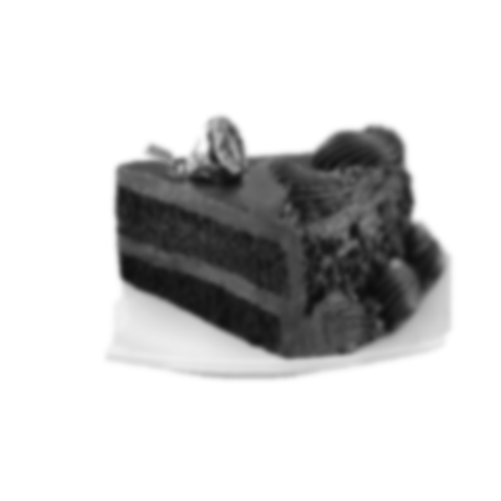
CART ADMINISTRATION
MANAGE INVENTORY
FRUIT SNACKS
COOKIE
X
APPLE
BANANA
X
X
X
ADD ITEM
Click the plus icon to add new items.
+
$0.50
$0.25
$0.75
$0.25
X
X
X
X
WATER
ORANGE JUICE
APPLE JUICE
SODA
APPLE
Click on any item to edit it.
$0.25
$0.50
$0.50
$0.50
$0.50
X
Click on the X to remove or archive an item.
X
X
ü
APPLE
X
CHIPS (LARGE)
PIE SLICE
CAKE
CHIPS (SMALL)
$0.50
$0.50
$0.75
$1.50
$0.25
ü
Click the checkmark icon to move an archived item back into active use.
CAKE
ADD ITEM
+
$0.25

Slide 4
ORDER SCREEN
APPLE
BANANA
COOKIE
FRUIT SNACKS
ORDER
$0.50
$0.25
$0.75
$0.25
WATER
ORANGE JUICE
APPLE JUICE
SODA
$0.25
$0.50
$0.50
$0.50
CHIPS (SMALL)
CHIPS (LARGE)
PIE SLICE
$0.50
$0.75
$1.50
TOTAL
$0.00
NEW ORDER
PAY

Slide 5

ORDER SCREEN
APPLE
BANANA
COOKIE
FRUIT SNACKS
ORDER
$0.50
$0.25
$0.75
$0.25
WATER
ORANGE JUICE
APPLE JUICE
SODA
$0.25
$0.50
$0.50
$0.50
CHIPS (SMALL)
CHIPS (LARGE)
PIE SLICE
$0.50
$0.75
$1.50
TOTAL
$0.25
NEW ORDER
PAY

Slide 6

ORDER SCREEN
APPLE
BANANA
COOKIE
FRUIT SNACKS
ORDER
$0.50
$0.25
$0.75
$0.25
WATER
ORANGE JUICE
APPLE JUICE
SODA
$0.25
$0.50
$0.50
$0.50
CHIPS (SMALL)
CHIPS (LARGE)
PIE SLICE
$0.50
$0.75
$1.50
TOTAL
$0.50
NEW ORDER
PAY

Slide 7
ORDER SCREEN
APPLE
BANANA
COOKIE
FRUIT SNACKS
ORDER
$0.50
$0.25
$0.75
$0.25
WATER
ORANGE JUICE
APPLE JUICE
SODA
$0.25
$0.50
$0.50
$0.50
CHIPS (SMALL)
CHIPS (LARGE)
PIE SLICE
$0.50
$0.75
$1.50
TOTAL
$1.00
NEW ORDER
PAY

Slide 8
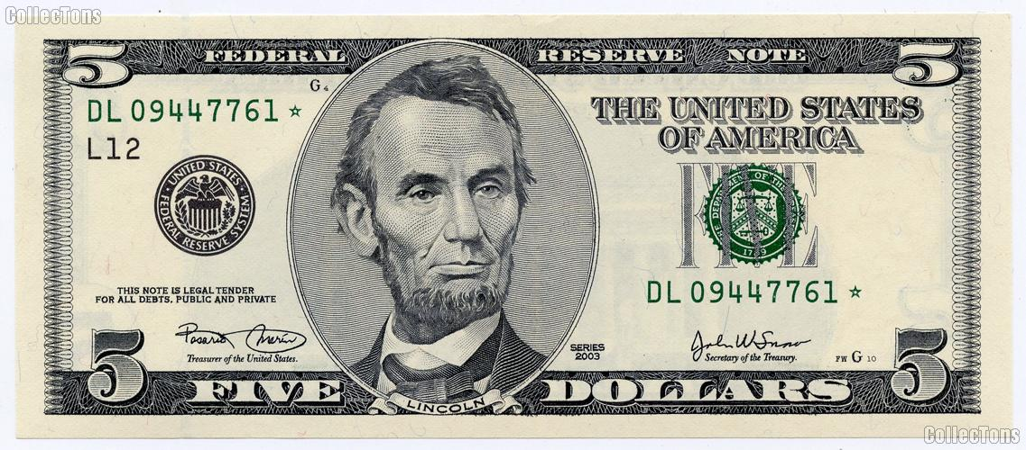
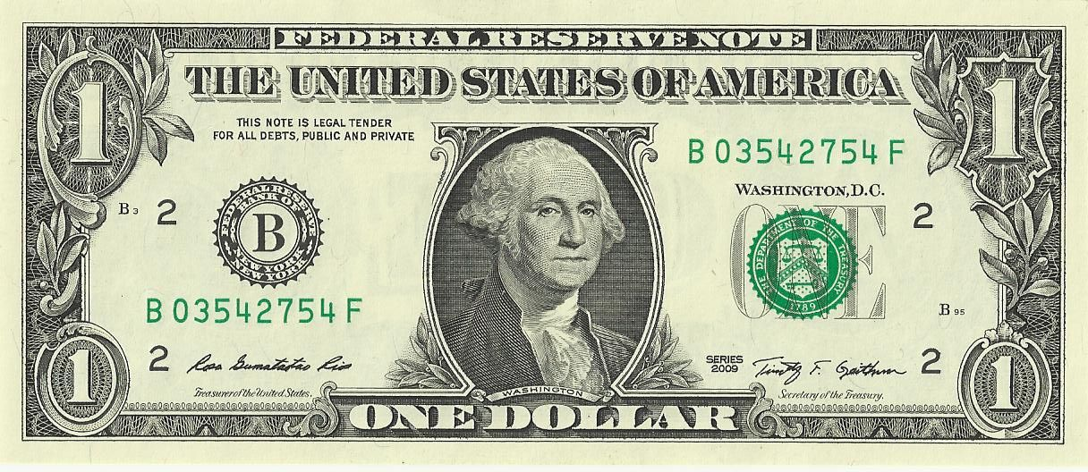

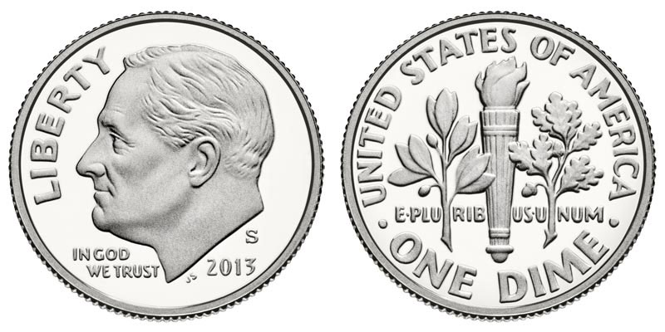
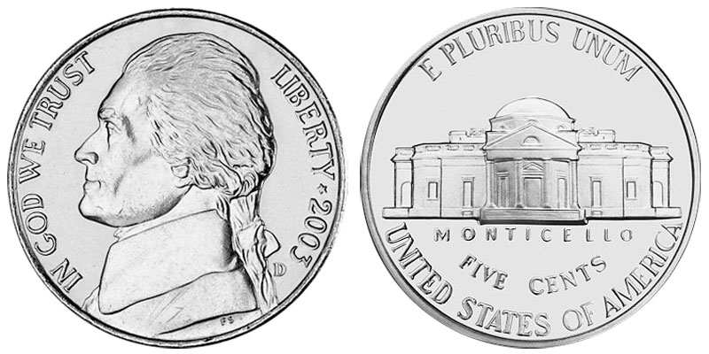
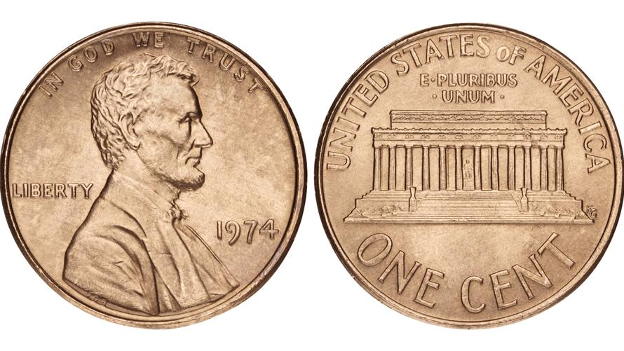
PAY SCREEN
RECEIVED
FIVE DOLLAR BILL $5.00
ONE DOLLAR BILL $1.00
QUARTER $0.25
DIME $0.10
NICKEL $0.05
PENNY $0.01
TOTAL
$1.00
PAID
$0.00
OWE
$1.00

Slide 9

PAY SCREEN
RECEIVED
FIVE DOLLAR BILL $5.00
ONE DOLLAR BILL $1.00
QUARTER $0.25
DIME $0.10
NICKEL $0.05
PENNY $0.01
TOTAL
$1.00
PAID
$0.10
OWE
$0.90

Slide 10
PAY SCREEN
RECEIVED
FIVE DOLLAR BILL $5.00
ONE DOLLAR BILL $1.00
QUARTER $0.25
DIME $0.10
NICKEL $0.05
PENNY $0.01
TOTAL
$1.00
PAID
$0.35
OWE
$0.65

Slide 11
PAY SCREEN
RECEIVED
FIVE DOLLAR BILL $5.00
ONE DOLLAR BILL $1.00
QUARTER $0.25
DIME $0.10
NICKEL $0.05
PENNY $0.01
TOTAL
$1.00
PAID
$0.60
OWE
$0.40

Slide 12
PAY SCREEN – REFUND NEEDED
RECEIVED
FIVE DOLLAR BILL $5.00
ONE DOLLAR BILL $1.00
QUARTER $0.25
DIME $0.10
NICKEL $0.05
PENNY $0.01
TOTAL
$1.00
PAID
$0.85
OWE
$0.15

Slide 13
PAY SCREEN – REFUND NEEDED
RECEIVED
FIVE DOLLAR BILL $5.00
ONE DOLLAR BILL $1.00
QUARTER $0.25
DIME $0.10
NICKEL $0.05
PENNY $0.01
TOTAL
$1.00
PAID
$0.95
OWE
$0.05

Slide 14
PAY SCREEN – REFUND NEEDED
RECEIVED
FIVE DOLLAR BILL $5.00
ONE DOLLAR BILL $1.00
QUARTER $0.25
DIME $0.10
NICKEL $0.05
PENNY $0.01
TOTAL
$1.00
PAID
$1.05
REFUND
$0.05

Slide 15
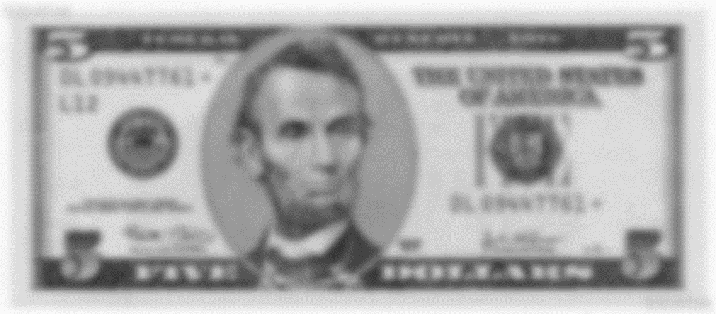
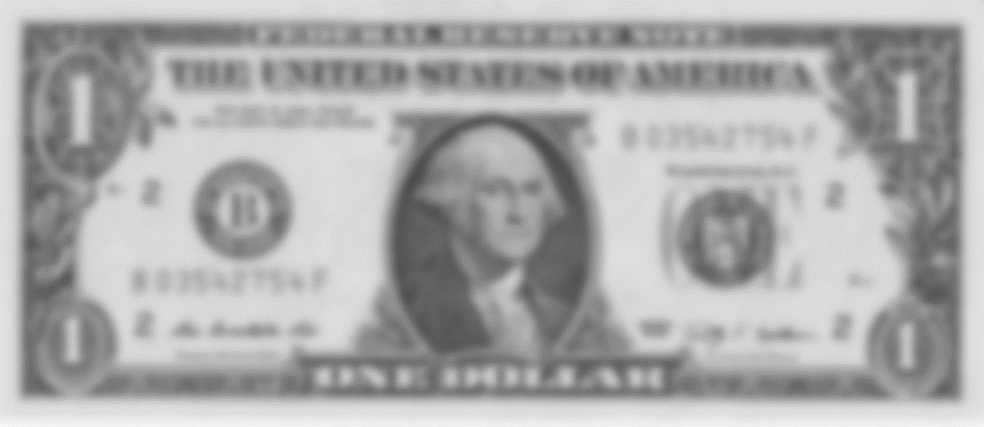


REFUND SCREEN
GIVEN
FIVE DOLLAR BILL $5.00
ONE DOLLAR BILL $1.00
QUARTER $0.25
DIME $0.10
NICKEL $0.05
PENNY $0.01
TOTAL
$1.00
PAID
$1.05
OWE
$0.05

Slide 16
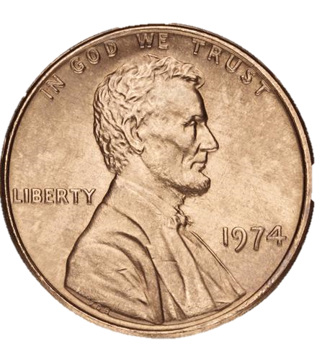

GIVEN
FIVE DOLLAR BILL $5.00
ONE DOLLAR BILL $1.00
QUARTER $0.25
DIME $0.10
NICKEL $0.05
PENNY $0.01
TOTAL
$1.00
PAID
$1.05
OWE
$0.04

Slide 17
GIVEN
FIVE DOLLAR BILL $5.00
ONE DOLLAR BILL $1.00
QUARTER $0.25
DIME $0.10
NICKEL $0.05
PENNY $0.01
TOTAL
$1.00
PAID
$1.05
OWE
$0.04

Slide 18
GIVEN
FIVE DOLLAR BILL $5.00
ONE DOLLAR BILL $1.00
QUARTER $0.25
DIME $0.10
NICKEL $0.05
PENNY $0.01
TOTAL
$1.00
PAID
$1.05
OWE
$0.04

Slide 19
GIVEN
FIVE DOLLAR BILL $5.00
ONE DOLLAR BILL $1.00
QUARTER $0.25
DIME $0.10
NICKEL $0.05
PENNY $0.01
TOTAL
$1.00
PAID
$1.05
OWE
$0.04

Slide 20
GIVEN
ü
FIVE DOLLAR BILL $5.00
ONE DOLLAR BILL $1.00
ORDER COMPLETED!
WELL DONE.
QUARTER $0.25
DIME $0.10
NEW ORDER
NICKEL $0.05
PENNY $0.01

Slide 21
ORDER SCREEN
APPLE
BANANA
COOKIE
FRUIT SNACKS
ORDER
$0.50
$0.25
$0.75
$0.25
WATER
ORANGE JUICE
APPLE JUICE
SODA
$0.25
$0.50
$0.50
$0.50
CHIPS (SMALL)
CHIPS (LARGE)
PIE SLICE
$0.50
$0.75
$1.50
TOTAL
$0.00
NEW ORDER
PAY

